Slide 1
Tracing rumours by analyzing social media data
Compiler Design - CS6109
Presented by,
Mohamed Abdul Malik J - 2018103043
Kutala Manoj - 2018103040
Gobinath A L - 2018103025

Slide 2
ABSTRACT
Social media generates huge amount of metadata that could be used to understand social information flow, identify how spreading happens, etc. Many kinds of such metadata could be represented as temporal networks, networks that record when contacts happen, in addition to who has been in contact with whom. The field of temporal networks is still under rapid development. There are a number of techniques to analyse social media data sets.These methods serve to identify important spreaders, characterize the behaviour of the social media users, and map out temporal ad topological structures. In our project, we will construct a temporal network using social media metadata and find the influential and important spreaders. Influential spreader is the one who can influence many others.Important spreaders are the ones who play a vital role in boosting the spreading process.

Slide 3
Literature Survey
SNO | AUTHOR,PUBLICATION,YEAR | METHODOLOGY | ADVANTAGES | LIMITATIONS
1 | PETTER HOLME “ANALYZING TEMPORAL NETWORKS IN SOCIAL MEDIA”, 2014 | RANDOMIZING THE NETWORK | IMPORTANCE OF A NODE IN A NETWORK CAN BE STUDIED | MAY NOT BE SUITABLE FOR ANALYZING IF THE NETWORK CONTAINS MANY CYCLES
2 | P. HOLME AND J. SARAMA, ‘‘TEMPORAL NETWORKS’’, 2012 | ALGORITHM TO IDENTIFY TIME RESPECTING COMPONENTS IN A NETWORK | MAKES IT EASY TO TRACK THE ORIGIN OF MESSAGE | MAY NOT WORK IF THE NETWORK DOESN’T HAVE ANY NODE WITH INDEGREE AS 0

Slide 4
Problem Statement
Given the social media data containing conversations with timestamp, trace the message requested by the user and identify the influential and important spreaders of the message

Slide 5
Architecture Diagram
Mohamed Abdul Malik J
Manoj Kutala
Gobinath A L
Data preprocessing
Contact Sequence
Temporal Network Construction
Time respecting paths identification
Social media data
Simplification and spreaders identification
Randomization of model

Slide 6
MODULE 1 - Data Preprocessing
Input: Social media metadata which is stored as csv file
Output: Preprocessed data
Pseudocode:
Read the CSV file and store it as multi-dimensional array object, D.
Maintain a set of unique and preprocessed messages, say S and also a message list, L.
for every item in D:
extract the message part, M
if M not in S:
add M to S
add M to L.
print all the unique messages
Ask the user to trace which message, say X.
Return all rows(subArrays) in D containing the message X.

Slide 7
MODULE 2 -Contact Sequence Identification
Input: Preprocessed data of module 1
Output: Contact Sequence
Pseudocode:
Maintain a dictionary D with,
Key: Sender Name
Value: Receiver Name, Message sent time
for every message in preprocessed message list:
D[Sender name] += [Receiver Name, Message sent time]
for (key,value) pair in D:
print ( Sender name (key) : [Receiver name, message sent time] (value) )

Slide 8
MODULE 3 - Temporal network construction:
Input: Contact Sequence
Output: Temporal Network
Pseudocode:
Create a graph G
Initially, first Sender as root node R of G
Make recipients of first Sender as child nodes of the root node R
Draw an edge between root and child nodes, labelling message sent time.
for every child node, C:
make all recipients children of C
draw edge E between C and children (C1…Ck), labelling message sent time
repeat the process until no more child nodes

Slide 9
MODULE 4 - Time respecting paths identification:
Input: Temporal network
Output: List of time respecting paths
Pseudocode:
Maintain an adjacent matrix which consists of adjacent nodes to a particular node
Maintain a set called Timerespectingpath which is initially empty
Find indegree of nodes
For each node x whose indegree=0 in temporal network:
For each node in adjacent(x):
DFS Traversal
UpdatePathOrder()
Timerespectingpath += traversedPath
Return timerespecting path

Slide 10
MODULE 5 - Randomization of model:
Input: Temporal Network, Time-respecting paths
Intermediate Output: Randomized models
Output: Score calculated for each node
Pseudocode:
1)Go over all edges sequentially.
2)For every edge (i,j):
pick another edge (i’,j’).
3)With a probability 1/2, replace (i,j) and (i’,j’) by (i,j’) and (i’,j) otherwise, replace them by (i,i’) and (j,j’).
4)If the move in step 3) created a self-edge or a multiple-edge, then undo it and start over from step 1).

Slide 11
MODULE 6 - Simplification and spreaders identification:
Pseudocode:
Percentagelist = calculatepercentage(module5output)
For each node in Temporal Network:
findindegree(node)
findoutdegree(node)
for i,element in enumerate(indegree):
If element == 0:
print(“influential spreader”, i+64)
maxElement = findMaxElemet(percentagelist)
For i,element in enumerate(percentagelist):
If element == maxElement && if element > 20%:
print(“Important spreaders”,i+64)
End for
Input: Calculated score
Output: Influential and important spreaders

Slide 12
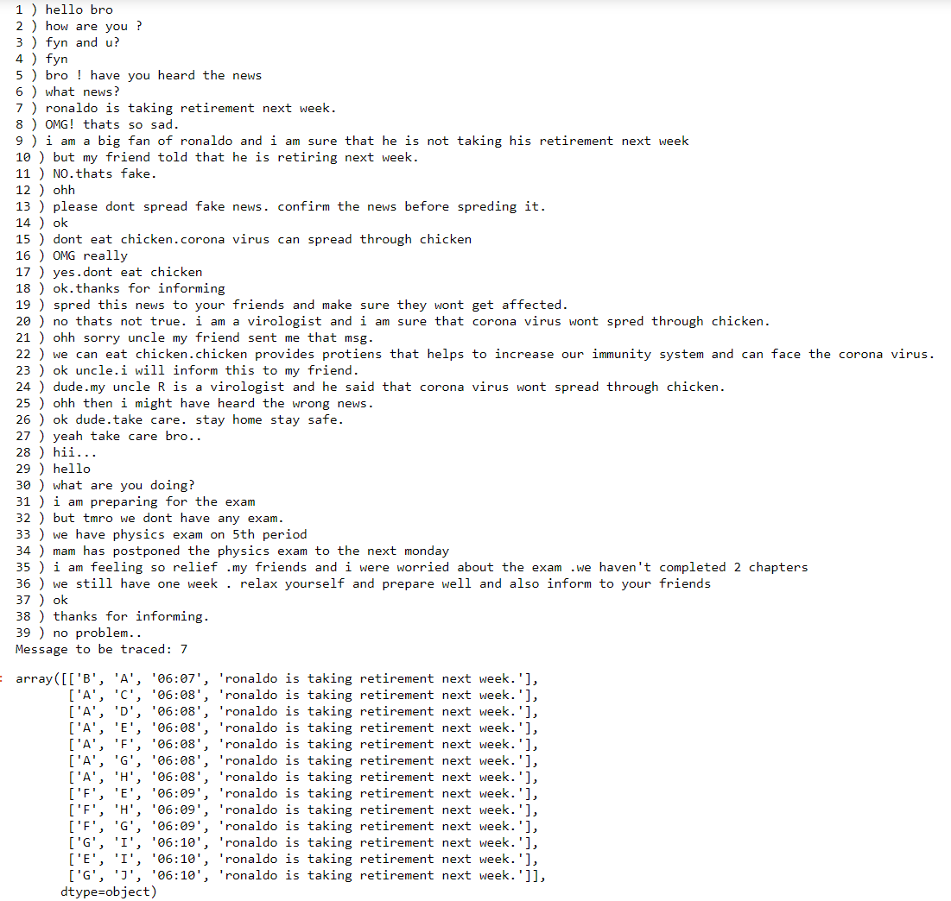
MODULE 1 OUTPUT

Slide 13
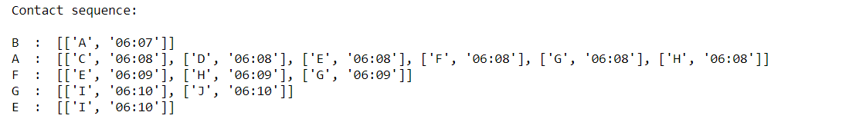
MODULE 2 OUTPUT

Slide 14
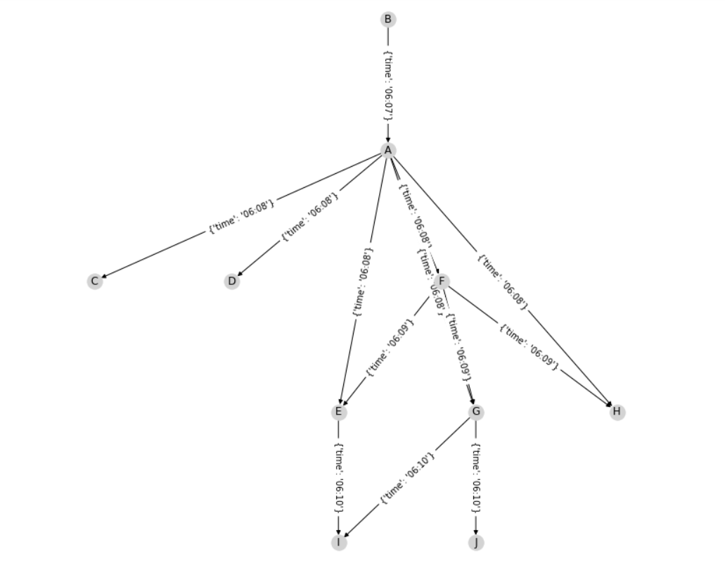
MODULE 3 OUTPUT

Slide 15
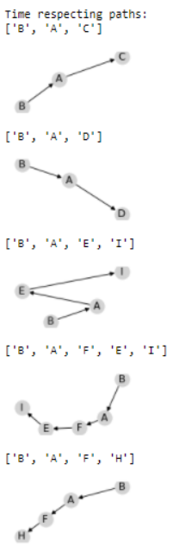
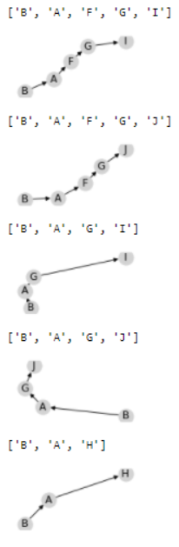
MODULE 4 OUTPUT

Slide 16
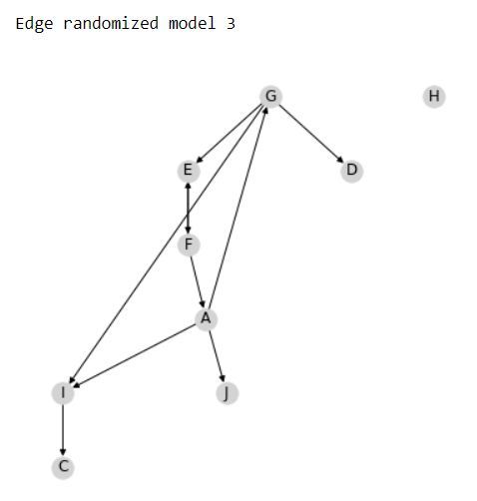
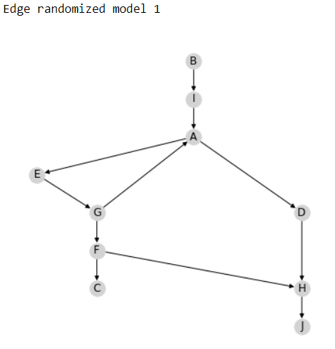
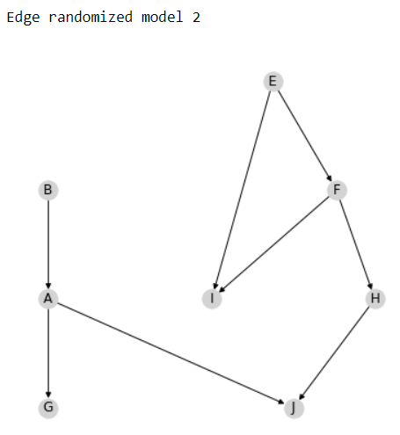
MODULE 5 OUTPUT

Slide 17
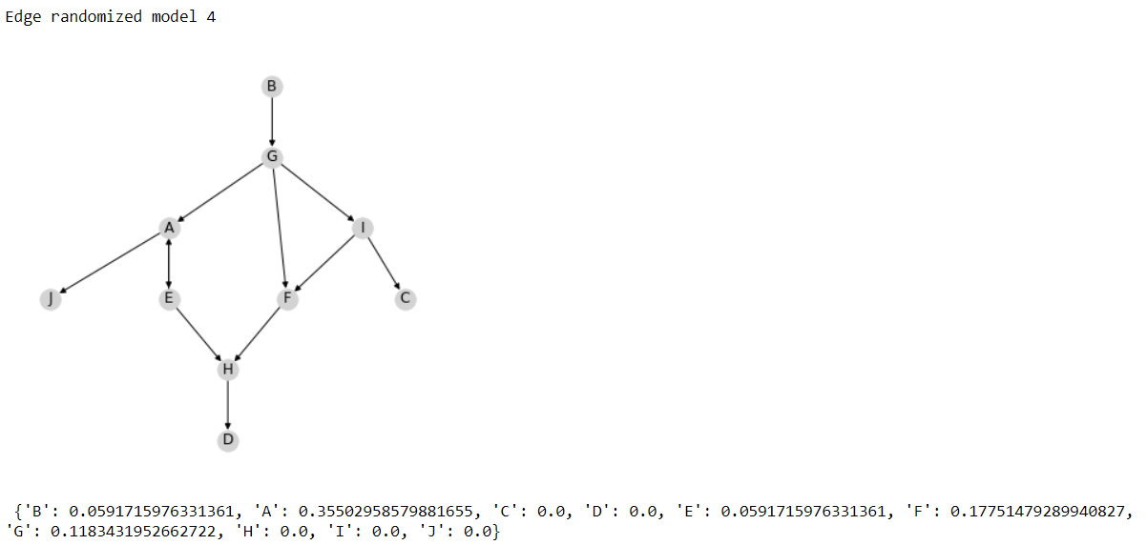

Slide 18
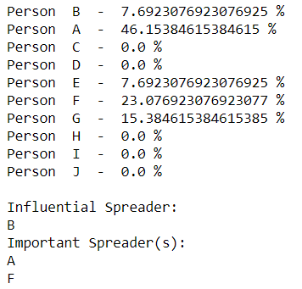
MODULE 6 OUTPUT

Slide 19
REFERENCES
BASE PAPER:
https://drive.google.com/file/d/1cc-Imr9Looh5t-ZH95UAUl5JX7bGoeBG/view?usp=sharing
P. HOLME AND J. SARAMA¨KI, ‘‘TEMPORAL NETWORKS,’’ PHYS. REP., VOL. 529, PP. 97–125, 2012.
J.-P. ECKMANN, E. MOSES, AND D. SERGI, ‘‘ENTROPY OF DIALOGUES CREATES COHERENT STRUCTURES IN E-MAIL TRAFFIC,’’ PROC. NAT. ACAD. SCI. USA, VOL. 101, PP. 14333–14337, 2004
H. EBEL, H.-I. MIELSCH, AND S. BORNHOLDT, ‘‘SCALE-FREE TOPOLOGY OF E-MAIL NETWORKS,’’ PHYS. REV. E, VOL. 66, 2002, 035103
B. VISWANATH, A. MISLOVE, M. CHA, AND F. P. GUMMADI, ‘‘ON THE EVOLUTION OF USER INTERACTION IN FACEBOOK,’’ IN PROC. 2ND ACM WORKSHOP ONLINE SOCIAL NETW., 2009, PP. 37–42.
S. A. GOLDER, D. M. WILKINSON, AND B. A. HUBERMAN, ‘‘RHYTHMS OF SOCIAL INTERACTION: MESSAGING WITHIN A MASSIVE ONLINE NETWORK,’’ IN COMMUNITIES AND TECHNOLOGIES 2007, C. STEINFIELD, B. T. PENTLAND, M. ACKERMAN, AND N. CONTRACTOR, EDS. LONDON, U.K.: SPRINGER-VERLAG, 2007, PP. 41–66.

